Slide 1

Notes:
This should be the title slide for all corporate presentations pertaining to the overall university level

Slide 2

Faculty of Engineering and Technology
Department of Computer Science and Medical Engineering
Notes:
This is the title slide for respective colleges/institutions while we retain the DMIHER logo on top always.

Slide 3

B.Tech Semester IV Project Based Learning-II Presentation

Slide 4
Presentation
on
GLAUCOMA DETECTION USING
DEEP LEARNING
Name of Students : Aditya Shete
Name of Mentor : Dr. Subodh Daronde.
DEPARTMENT OF COMPUTER SCIENCE AND MEDICAL ENGINEERING,
FACULTY OF ENGINEERING AND TECHNOLOGY,
SAWANGI (MEGHE), WARDHA

Slide 5
CONTENTS
Introduction
Aim
Objectives
Methodology
Result
Conclusion
References

Slide 6
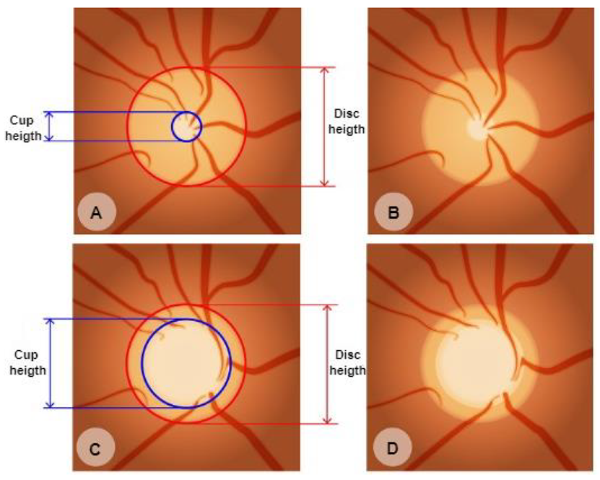
INTRODUCTION
Glaucoma is a serious eye disease that damages the optic nerve and can lead to permanent vision loss.
It is often caused by high eye pressure and is more common in older people.
Glaucoma is known as the "silent thief of sight" because it develops slowly over time
It is often caused by increased intraocular pressure (IOP) and affects millions of people worldwide.

Slide 7
AIM
Develop a Deep learning model for detection of Glucoma.

Slide 8
OBJECTIVES
To create a predictive model using CNN.
Develop a strong system by using many different types of eye images to improve model performance..
Design a CNN-based model to automatically detect glaucoma from retinal fundus images..

Slide 9

LITERATURE REVIEW
S.No | Authors | Findings | Technique | Limitations
1 | Ruben Hemelings, Bart Elen, Joao Barbosa‑Breda, Matthew B. Blaschko, Patrick De Boever & Ingeborg Stalmans | modified the training images in a standardized manner, this study revealed a recurrent pattern in inferotemporal and superotemporal regions neighboring the ONH and the ONH itself. | classification CNN | The proposed model did not explicitly assess the influence of myopic changes, did not analyze the role of the disease stage.
2 | Naganagouda Patil1 & Preethi N. Patil & P. V. Rao | Image size is the first evaluation with learning rate of 0.1, 0.01, 0.001 and 0.0001. The high performance is achieved with 0.001 learning rate. | deep learning (DL), with deep-belief network (DBN) | Dataset used is an unbalanced dataset totally 20.92% glaucoma images together with 79.08% normal images are used.

Slide 10
3 | Oluwatobi Joshua Afolabi , Gugulethu P. Mabuza-hocquet , Fulufhelo V. Nelwamondo, And Babu Sena Paul | The use of CDR threshold of 0.6 may only be suitable for this database. It was found out that extracting 5 features did not give a full view of the changing geometry of the optic cup and disc and extracting more than ten (10) features only resulted into duplication of data | U-Net Lite and Extreme Gradient Boost (XGB) | The proposed model does not works on low quality images.
4 | Wang Min Liao, BeiJi Zou, RongChang Zhao, Yuan Qiong Chen, ZhiYou He, and MengJie Zhou, | The researchers observed that the result of glaucoma diagnosis is improved with the increasing of optic disc segmentation,removed batch normalization layers and drop out reduced to 0.2 to reduce the overfitting model. | novel clinical interpretable ConvNet architecture (EAMNet) | This model is worked on ORIGA dataset which is unbalanced dataset because it contains 168 glaucomatous and 482 normal fundus images.

Slide 11
5 | Guangzhou An, Kazuko Omodaka, Kazuki Hashimoto, Satoru Tsuda, Yukihiro Shiga, Naoko Takada,Tsutomu Kikawa, Hideo Yokota, Masahiro Akiba and Toru Nakazawa | The machine learning system described can accurately differentiate between healthy and glaucomatous subjects based on their extracted images from OCT data and color fundus images. | optical coherence tomography and Transfer learning of convolutional neural network | This study include a relatively small study population.

Slide 12
Dataset Description
ACRIMA
ACRIMA database is composed by 705 fundus images All images from ACRIMA database were annotated by glaucoma experts with several years of experience. They were cropped around the optic disc and renamed.
DRISHTI-GS
This Dataset contains 50 train images and 51 test Images. In Each Directory there are two folders one is images and the second one is GT. The later folder contains Optic Disk and Cup masks associated with the images in the Images folder.
RIMONE
The RIM-ONE
database contains 169 optic nerve head images. Each image has 5 manual segmentations from ophthalmic experts. A gold standard for each image was created from its corresponding segmentations.

Slide 13


METHODOLOGY
ACRIMA
COMBINED
Data Augmentation Using Image Data Generator
Feature Selection using CNN
Classification using CNN
RIMONE
Not Glucoma
DRISHTi
No
Glucoma
Glucoma
Yes

Slide 14
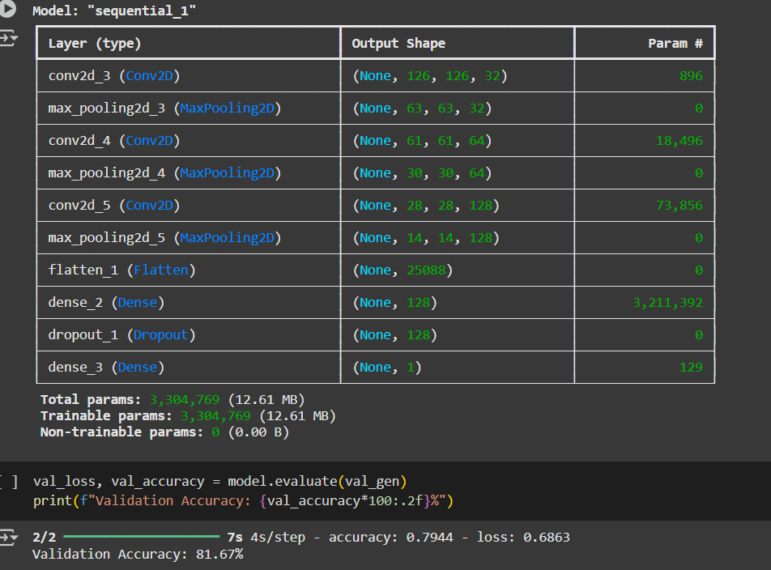
PROPOSED Model:

Slide 15

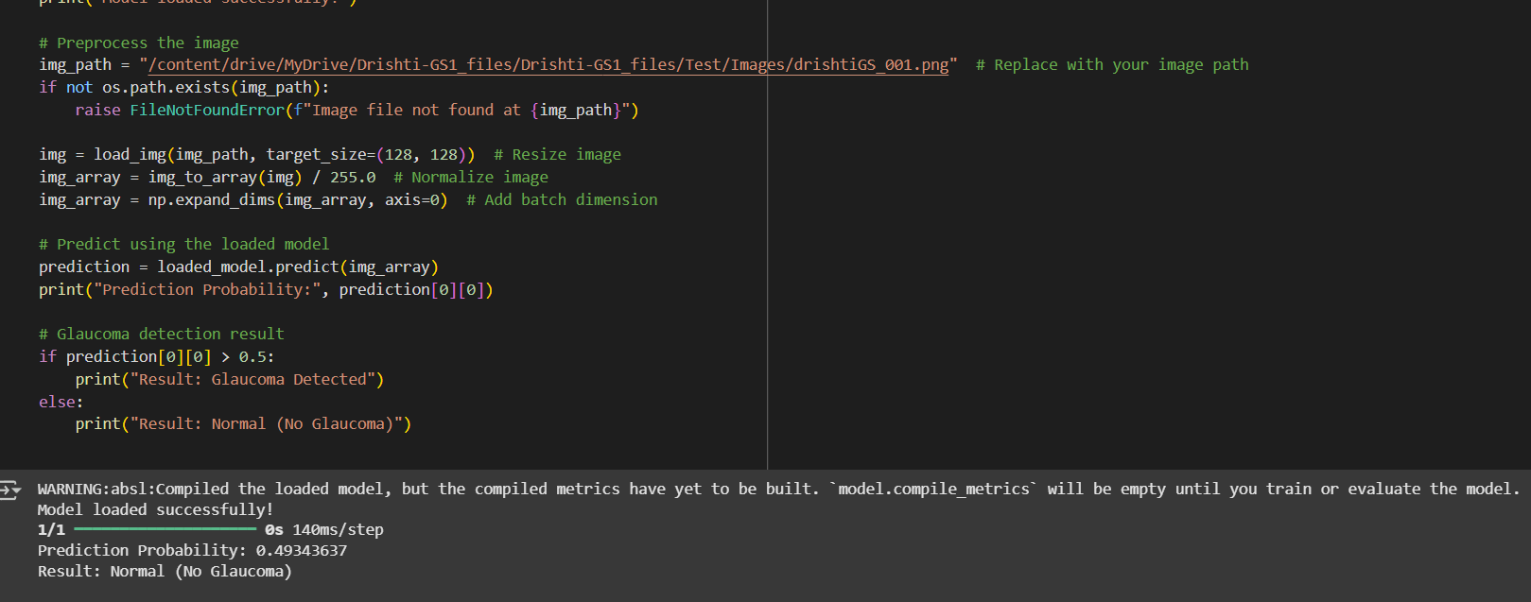
PROPOSED RESULT:

Slide 16
ACCURCY

Slide 17
CONCLUSION
This study shows a smart way to detect glaucoma using enhanced images. The classification report here instigates the fact that this model which achieved an accuracy of 81.67% with an integrated dataset is to be noted. The CNN here can process even on low quality images. The dataset created is a balanced dataset with equitable number of glaucoma and normal images.

Slide 18
REFERENCES
References should be in IEEE Format
Font size 12
Spacing 1.5

Slide 19
THANK YOU

